Slide 1
Medhat
The Medical Chatbot
Mennatallah Mohei
Gehad Abdelrahman
Mohamed Salem
Mahmoud Barbary
Ayman Talaat
Supervisors : Dr Ahmed Salama Dr Mohamed Sharkawi

Slide 2
TABLE OF CONTENTS
01
Introduction
Data Cleaning
02
03
UML Diagrams
04
05
Database
Design
06
Database
implementation
07
Chatbot implementation
Data Collection
08
Application development

Slide 3

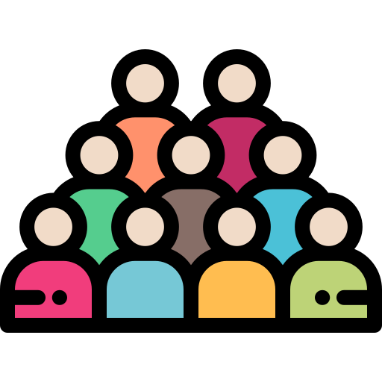



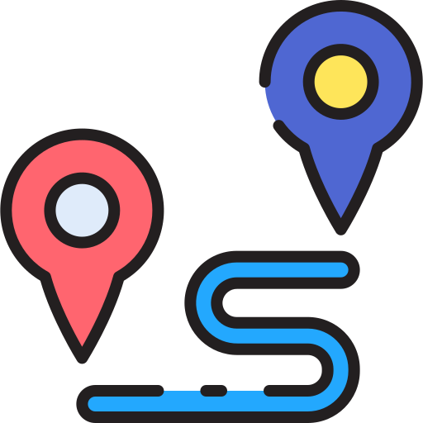
Motivation
Healthcare is rarely accessible or personalized.
The Medical Field is often complex with limited awareness.
People recently have been more anxious and careful.
They often face financial, geographical or time barriers.
Certain regions house a poor healthcare system.

Slide 4
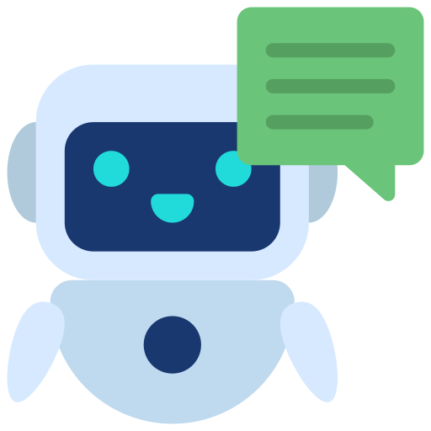
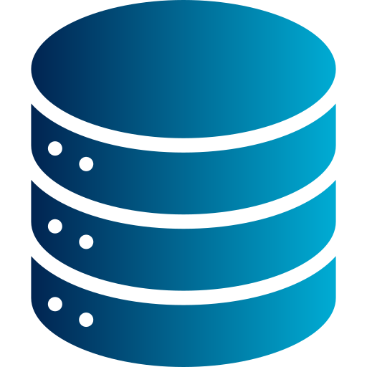
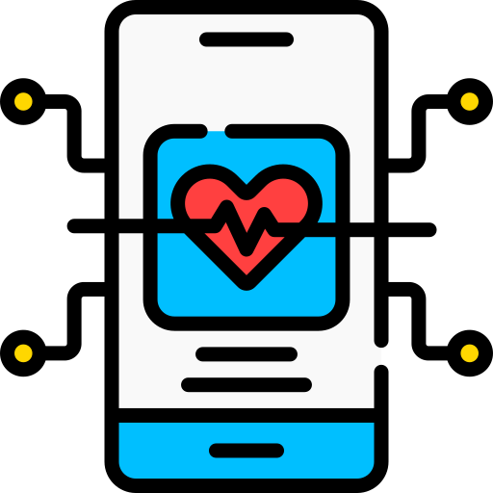



Introduction
The Solution: Medhat
Accessible, user-friendly gate to the medical field.
Powerful & simple medical information search engine.
Promotes healthcare awareness.
Relieves any doubts for the user.
Recommends the best course of action.
Provides news for outbreaks or advancements.

Slide 5
Objective
Vision:
To empower individuals worldwide with accessible and reliable healthcare information and support through our medical AI chatbot, fostering a healthier and more informed global society.
Mission:
Our mission is to provide a trusted and accessible medical AI chatbot, delivering evidence-based health information and guidance to users, promoting better health decisions through AI technology and a user-friendly design.

Slide 6
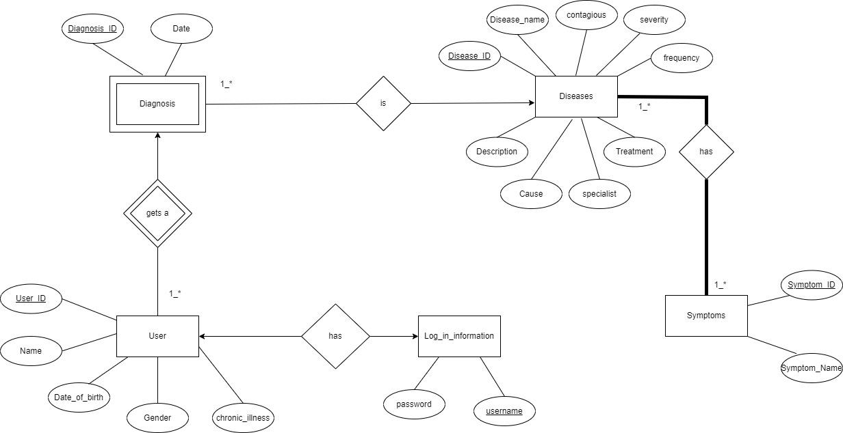
E-R Diagram

Slide 7
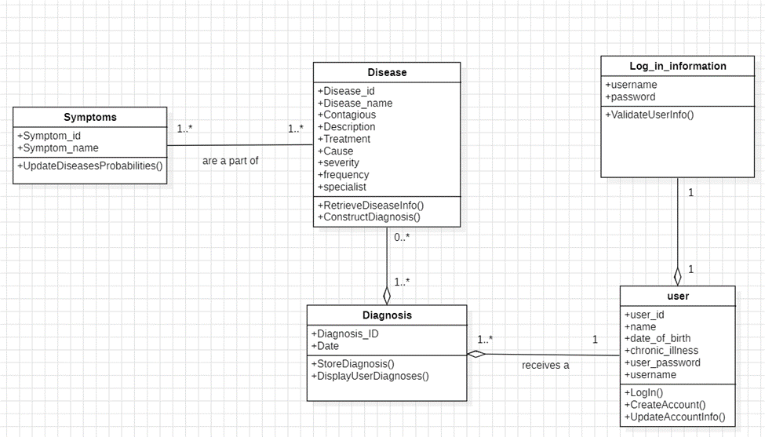
Class Diagram

Slide 8
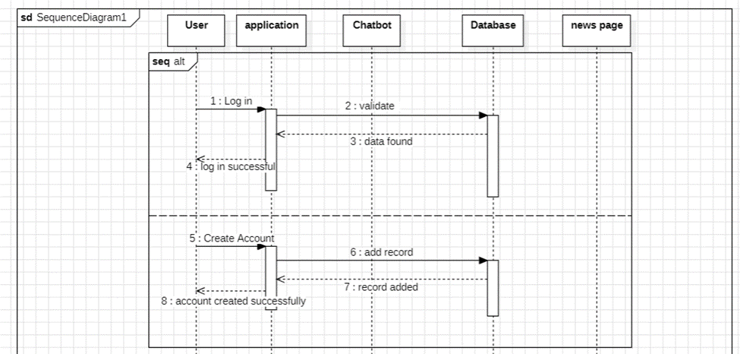
Sequence Diagram

Slide 9
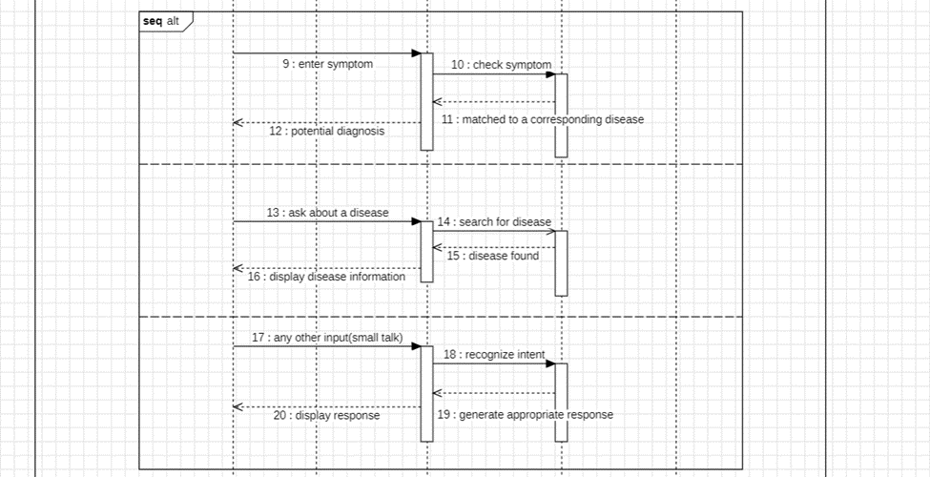
Sequence Diagram

Slide 10
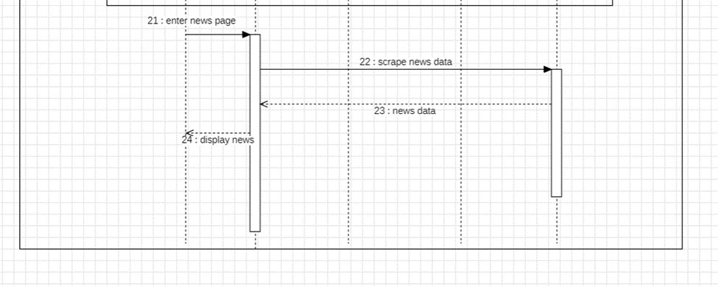
Sequence Diagram

Slide 11
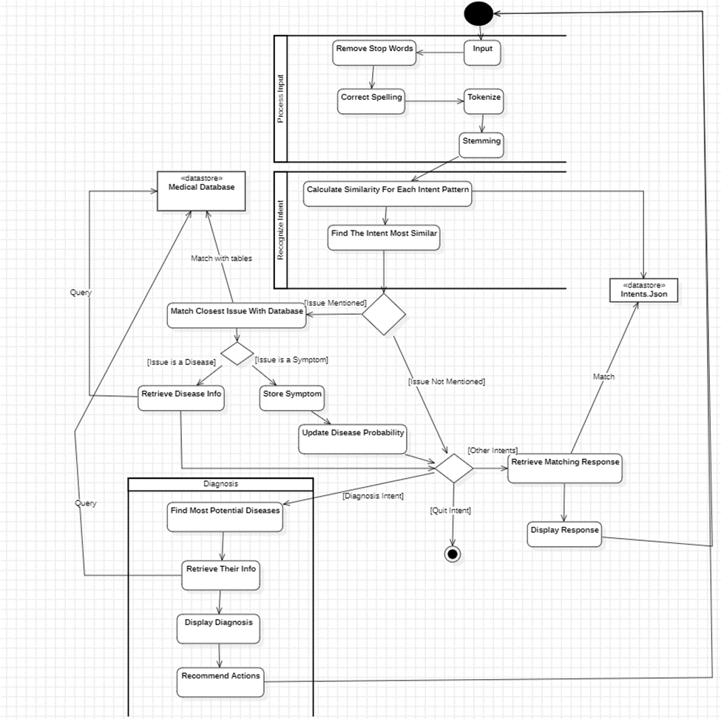
Activity
Diagram

Slide 12
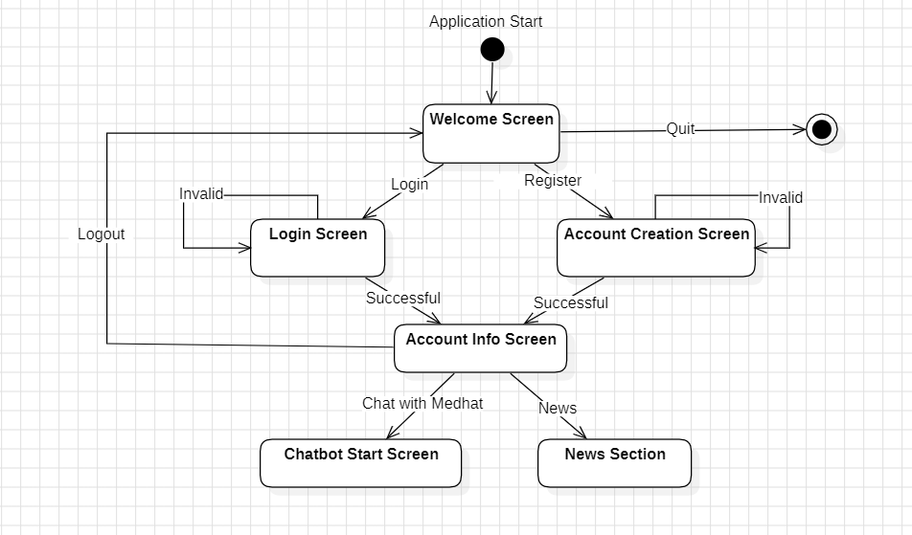
State-Transition Diagram

Slide 13
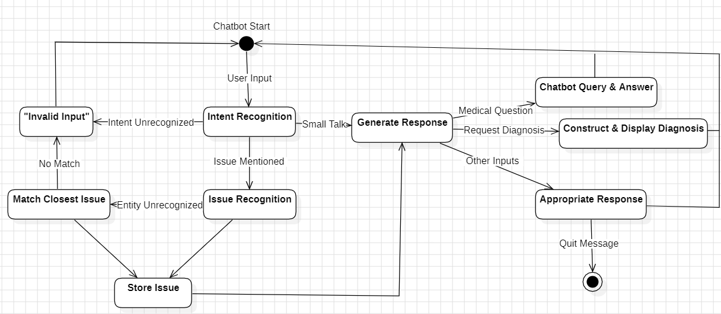
State-Transition Diagram

Slide 14
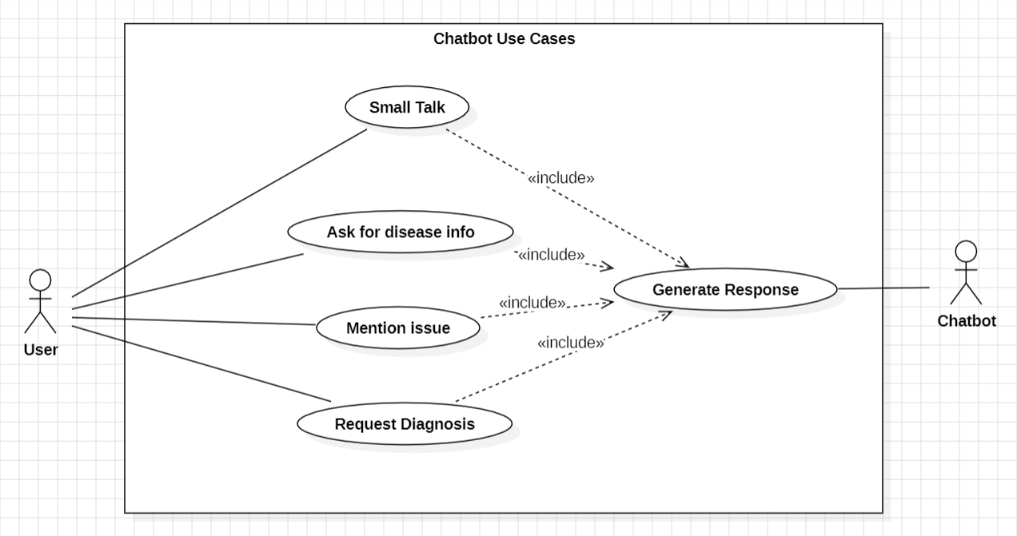
Chatbot Use Cases

Slide 15
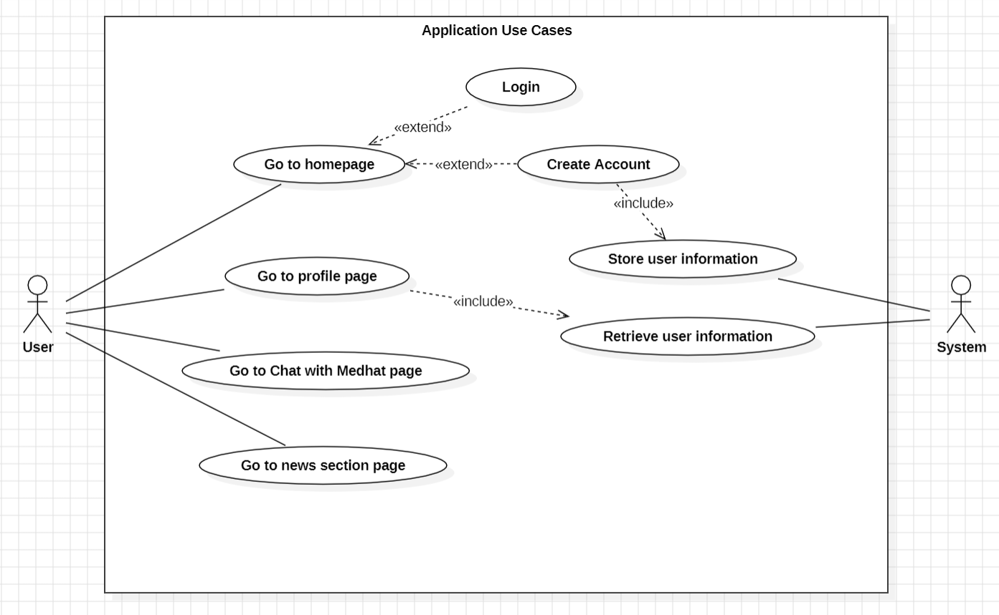
Application Use Cases

Slide 16
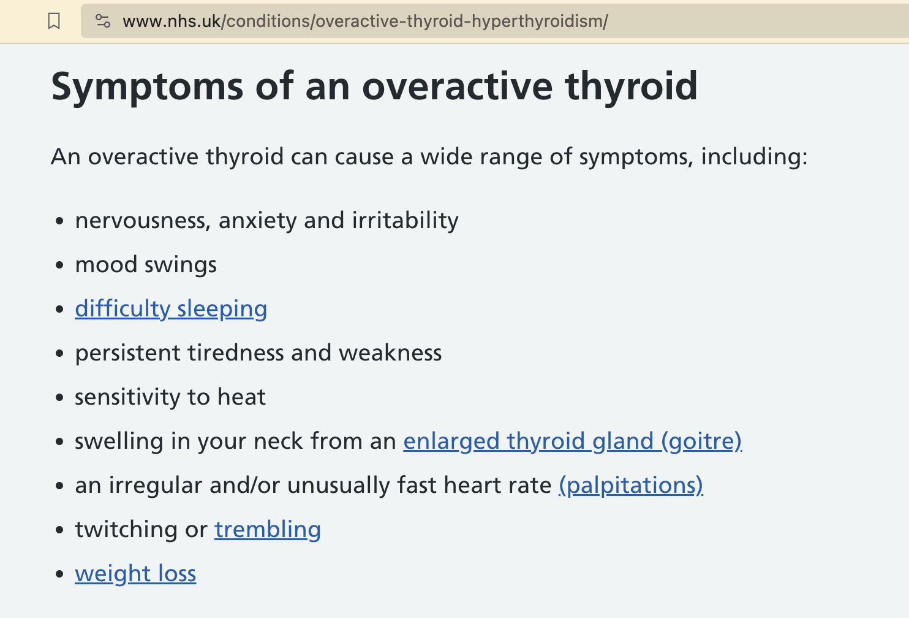
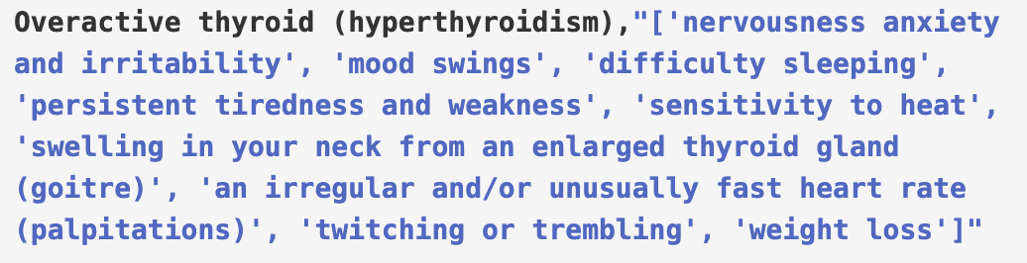
Web Scraping
Python script to scrape NHS health guide website.
Process is repeated for symptoms, causes, treatments, and description.
Data is accumulated in CSV files to be analyzed and cleaned.
NHS Website
Data from Web Scraping

Slide 17
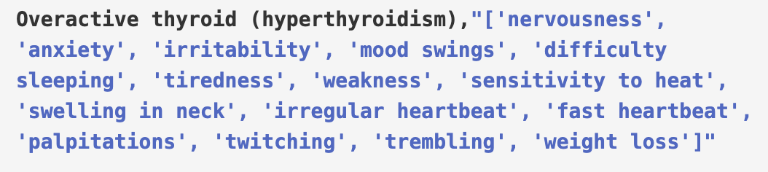
Data Cleaning
Data is reviewed for anomalies.
Data is manually edited and cleaned to maintain accuracy.
Data is standardized across the dataset.
Data from Web Scraping
Manually Cleaned Data

Slide 18
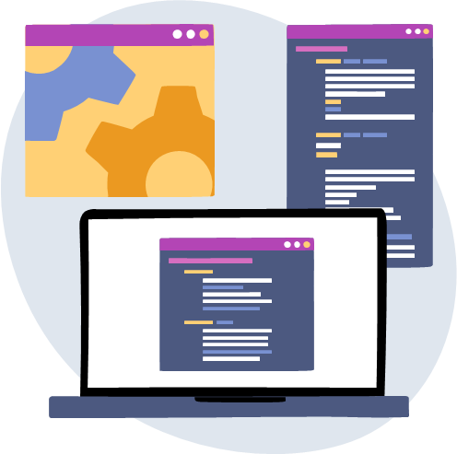
Database Implementation
PostgreSQL as the DBMS
Creating the database and all the required tables
Inserting data from the CSV files into the database using Python
A connection was established using a Python script
Chatbot queries the database

Slide 19
ChatBot Implementation
Migration from OCaml to Python
Main Functionalities:
Input Processing and Intent Recognition:
Utilized NLP tools for processing user input, enabling the chatbot to recognize user intent.
Symptom/Disease Detection:
Identifying the closest matching disease or symptom based on user input.
Response Generation:
Responses are based on recognized user intent.
Diagnoses are generated upon user request, based on the symptoms provided by the user.
Incremental Development Approach:
These functionalities were iteratively improved.

Slide 20
THANK YOU!

